Slide 1
Including Signed Languages in Natural Language Processing
CSE 431 : Natural Language Processing
Team members :
Somaya al sadia Rahman (20101560)
Richie

Slide 2
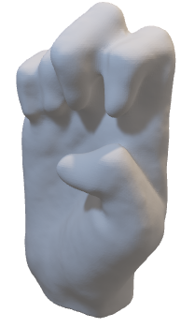
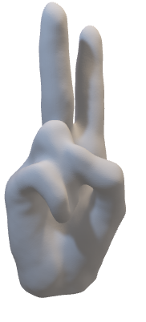

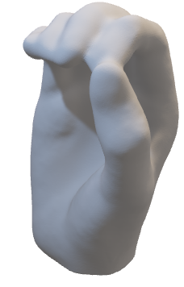
Introduction
Different kind of sign language

Slide 3
PREVIOUS WORK
1.Early works in SLP that were mostly limited to using sensors to capture fingerspelling and isolated signs, or use rules to synthesize signs from spoken language text.
2.Later a continuous signed language benchmark dataset coupled with the advent of deep learning for visual processing, lead to increased efforts to recognize signed expressions from videos.

Slide 4
CHALLANGES
visual-gestural modality
Simultaneity
CHALLENGES
spatial coherence
lack of written form

Slide 5
IMPROVEMENT
The adoption of an efficient tokenization method
The development of linguistically-informed models
The collection of real-world signed language data
The inclusion of local signed language communities

Slide 6
Sign Language Linguistics :
Phonology :composed of minimal units that combine manual features
Simultaneity :Though an ASL sign takes about twice as long to produce than an English word
Referencing :The signer can introduce referents in discourse either by pointing to their actual locations in space
Fingerspelling :Fingerspelling is a result of language contact between a signed language and a surrounding spoken language written form
Phonology
Finger
Spelling
Sign
Language
Linguistic
simultaneity
Reference

Slide 7
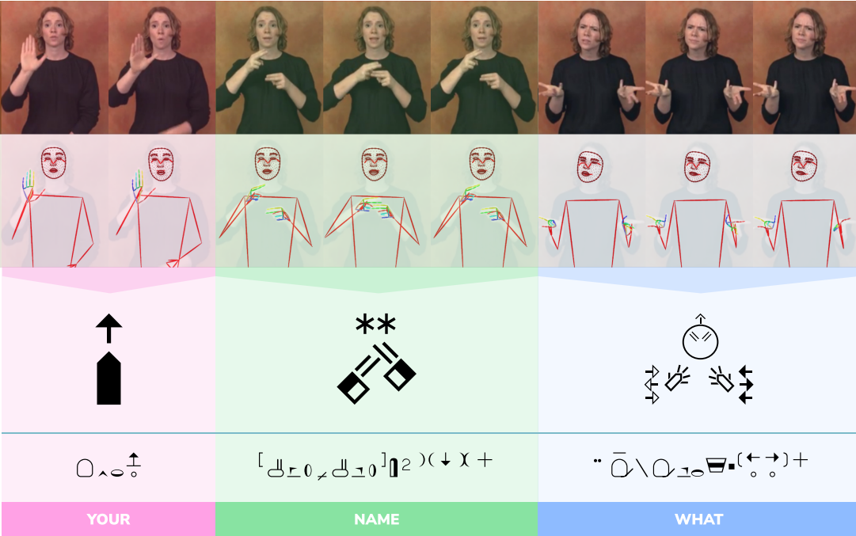
Current State of SLP
VIDEOS
STREAM
POSE
STREAM
SIGN
WRITING
HamNoSys
ASL Gloss

Slide 8
Fahad Khan Raj
ID: 20101250
Sec: 01

Slide 9
THE DIFFERENT FORMATS OF RESOURCES AND DISCUSSION ON HOW THEY CAN BE USED FOR SIGNED LANGUAGE MODELING.

Slide 10
TABLE OF CONTENTS
.
Bilingual dictionaries
Fingerspelling corpora
for signed language map a spoken language word or short phrase to
a signed language video.
usually consist of videos of words borrowed from spoken languages that are signed letter-by-letter.
Continuous sign corpora
Isolated sign corpora
contain parallel sequences
of signs and spoken language. Available
are collections of annotated
single signs.

Slide 11
TABLE OF CONTENTS
.
Availability
Unlike the vast amount and diversity of available spoken language resources that allow various applications, signed language resources are scarce and currently only support translation and
production.

Slide 12
Sign Language Processing Tasks
The CV community has mainly led the research on SLP so far to focus on processing the visual features in signed language videos. As a result, current SLP methods do not fully address the linguistic complexity of signed languages. We survey common SLP tasks and limitations of current methods by drawing on linguistic theories of signed languages.

Slide 13
WHAT IS THIS TOPIC ABOUT?
Detection
Segmentation
Translation
Production
Identification
Recognition

Slide 14
—Raj
THANK YOU

Slide 15
Including Signed Languages
in NLP

Slide 16
Name: Radoan Sharkar
ID: 20101263

Slide 17
INTRODUCTION
Towards Including Signed Languages in Natural Language Processing

Slide 18
TABLE OF CONTENTS
01
02
03
Building NLP Pipelines
Collect Real-World Data
Tokenization, Syntactic Analysis, Named Entity Recognition, Coreference Resolution
What is Good Signed Language Data?, Challenges of Data Collection
Practice Deaf Collaboration
Solving Real Needs, Building Collaboration Deaf

Slide 19
01
Building NLP Pipelines
Tokenization, Syntactic Analysis, Named Entity Recognition, Coreference Resolution

Slide 20
WHAT IS THIS TOPIC ABOUT?
Tokenization
Syntactic Analysis
Input to work with
Understanding the meaning of words in the context
Named Entity Recognition (NER)
Coreference Resolution
Finding relationship between name and entities
The task of determining linguistic expressions

Slide 21
DEFINITION OF CONCEPTS
Tokenization
Syntactic Analysis
Coreference Resolution
Named Entity Recognition (NER)

Slide 22
02
Collect Real-World Data
What is Good Signed Language Data?, Challenges of Data Collection

Slide 23
WHAT IS THIS TOPIC ABOUT?
What is Good Signed Language Data?
Challenges of Data Collection

Slide 24
DEFINITION OF CONCEPTS
A broad domain
Sufficient data and vocabulary size
Real-world conditions
Naturally produced signs
A diverse signer demographic
Native signers; and when applicable
Dense annotations
What is Good Signed Language Data?
Challenges of Data Collection

Slide 25
03
Practice Deaf Collaboration
Solving Real Needs, Building Collaboration Deaf

Slide 26
WHAT IS THIS TOPIC ABOUT?
Solving Real Needs
Building Collaboration Deaf

Slide 27
CONCLUSION
We urge the inclusion of signed languages in NLP. We believe that the NLP community is well positioned, especially with the plethora of successful spoken language processing methods coupled with the recent advent of computer vision tools for videos, to bring the linguistic insight needed for better signed language models. We hope to see an increase in both the interests and efforts in collecting signed language resources and developing signed language tools while building a strong collaboration with signing communities.

Slide 28
THANKS!
Do you have any questions? radoan.sharkar@g.bracu.ac.bd
RADOAN

